Slide 1


Education
Series
Topics
757BTC
https://www.757btc.org/

Slide 2

Topics
The Case for Bitcoin
Personal Digital Security
Blockchain 101
Bitcoin Layer 1,2, and 3
Cost/Benefit Bitcoin Custody
Mining 101
Bitcoin Tech and BIPs
Bitcoin Node and Lightning Node
Bitcoin for children

Slide 3
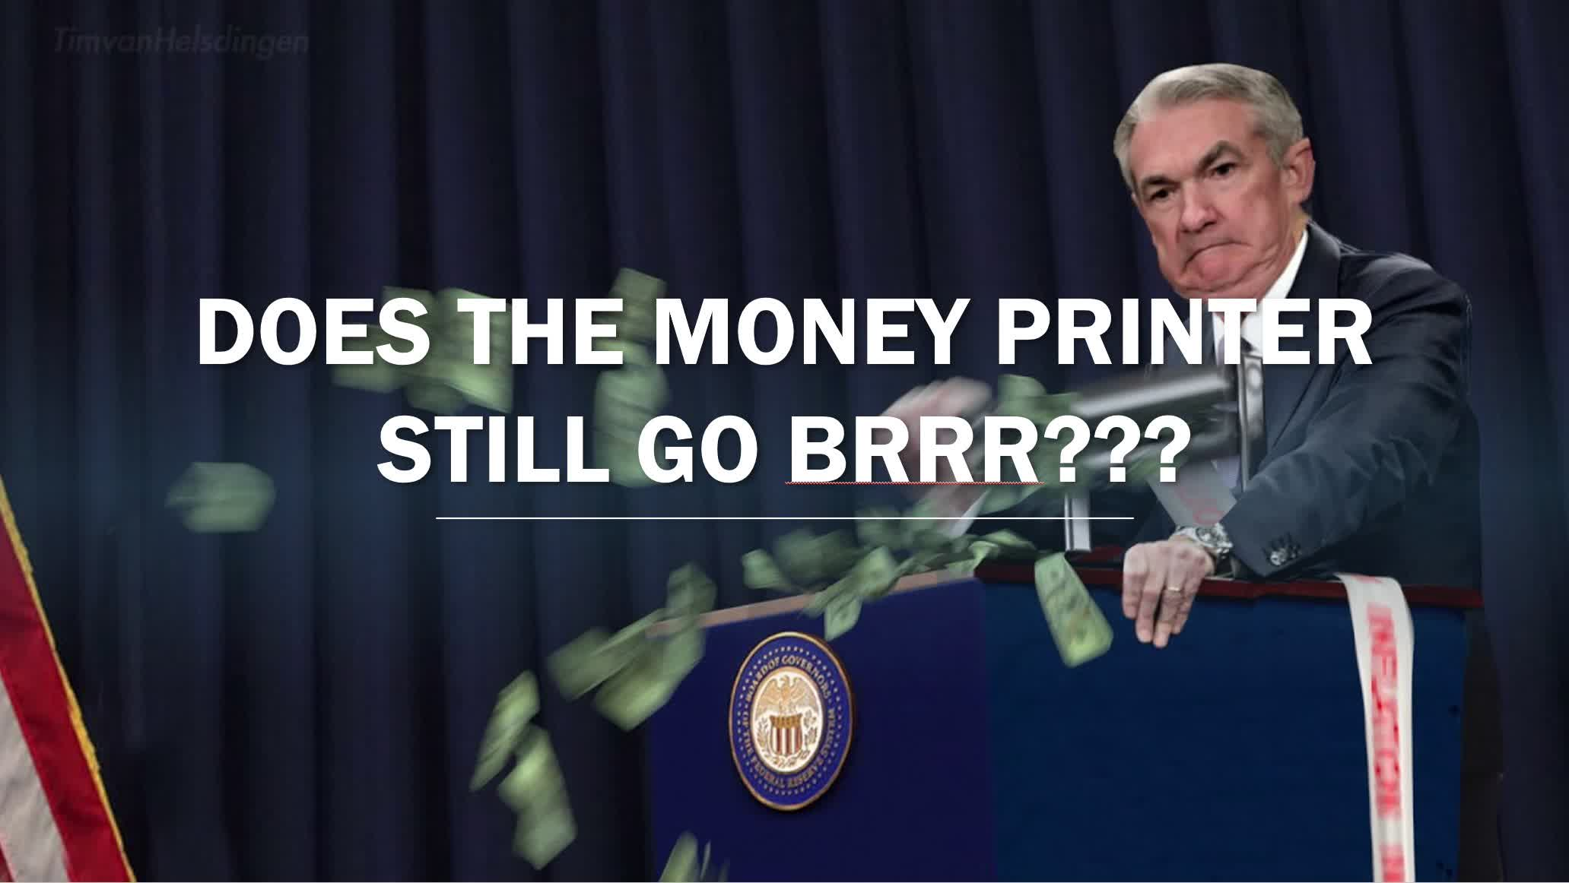
The Case for Bitcoin
Fix the money fix the world
Scarcity
Censorship Resistance
Unconfiscatable

Slide 4

Personal Digital Security
Password Manager
Digital Hygiene
Don’t Trust Verify
Identity

Slide 5
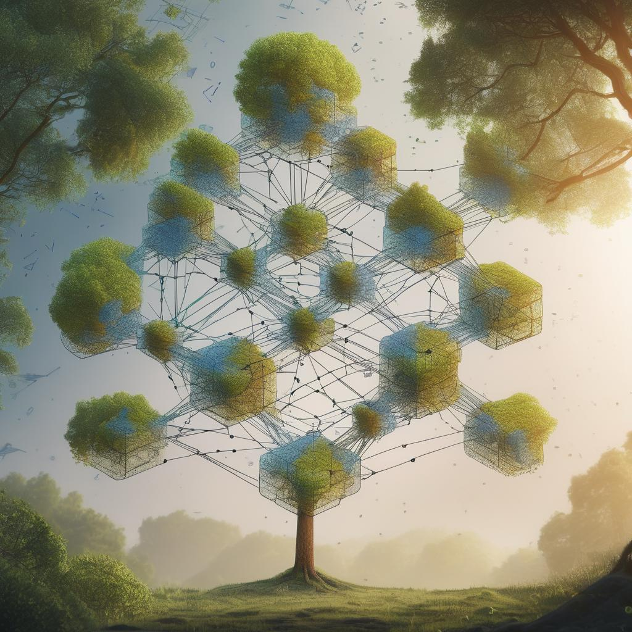
Blockchain 101
Cryptography Prereq
Consensus protocol
Public vs. Private
Incentives and Governance
Use Cases

Slide 6

Bitcoin Layer 1, 2, and 3
Typical tech stack, why layers
Bitcoin Layer 1 (Onchain)
Bitcoin Layer 2 (Liquid and Lighting)
Bitcoin Layer 3 (Cashu and Fedimint)

Slide 7
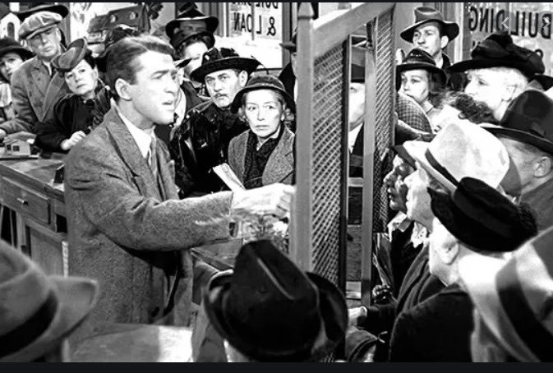

Cost/Benefit of Bitcoin Custody
Custodial vs non-Custodial
KYC and AML
Privacy Ramifications
Forward Privacy
Tips and Tools

Slide 8
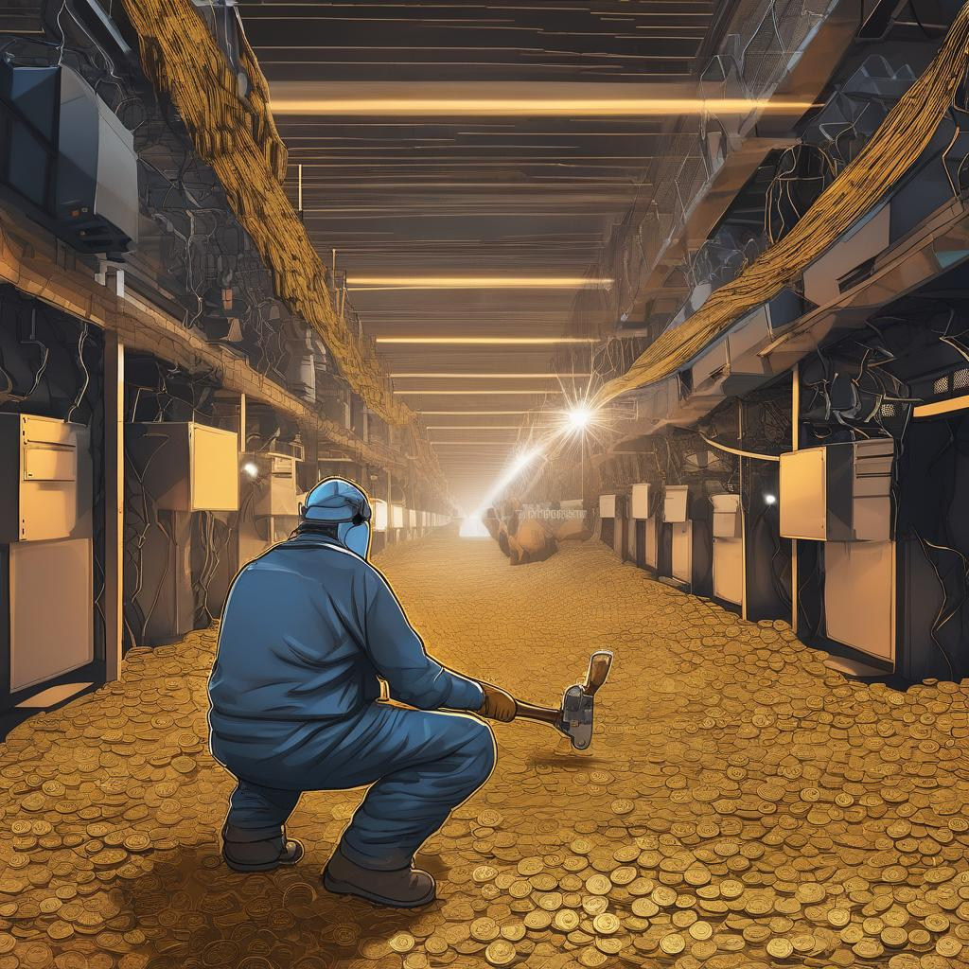
Mining 101
Things to consider
Cost/Benefit
Acquiring Miner
Power Infrastructure
Mining Pools

Slide 9

Bitcoin Tech and BIPs
Concept of the Node
Block structure
Mempool
Address Types
Proof of Work / Longest Chain
Bitcoin improvement proposal

Slide 10
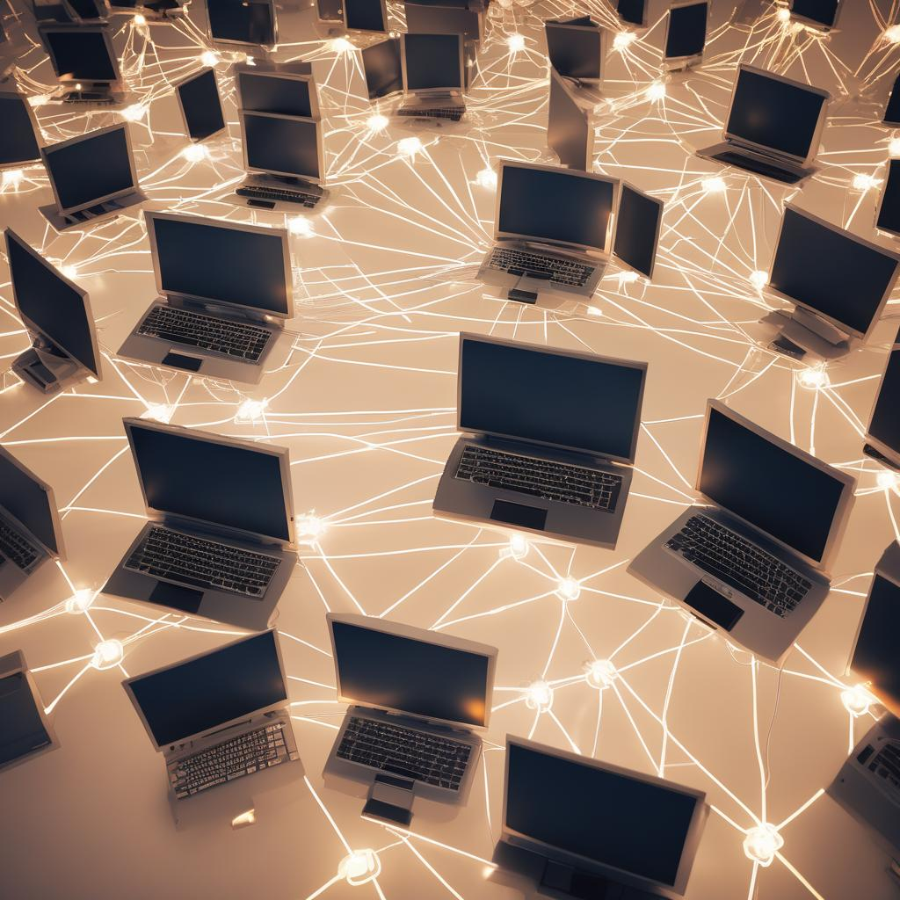
Bitcoin Node and Lightning Node Management
Hardware Requirements
Software Requirements
Node Packages
Lightning Node Management
“Uncle Jim”

Slide 11
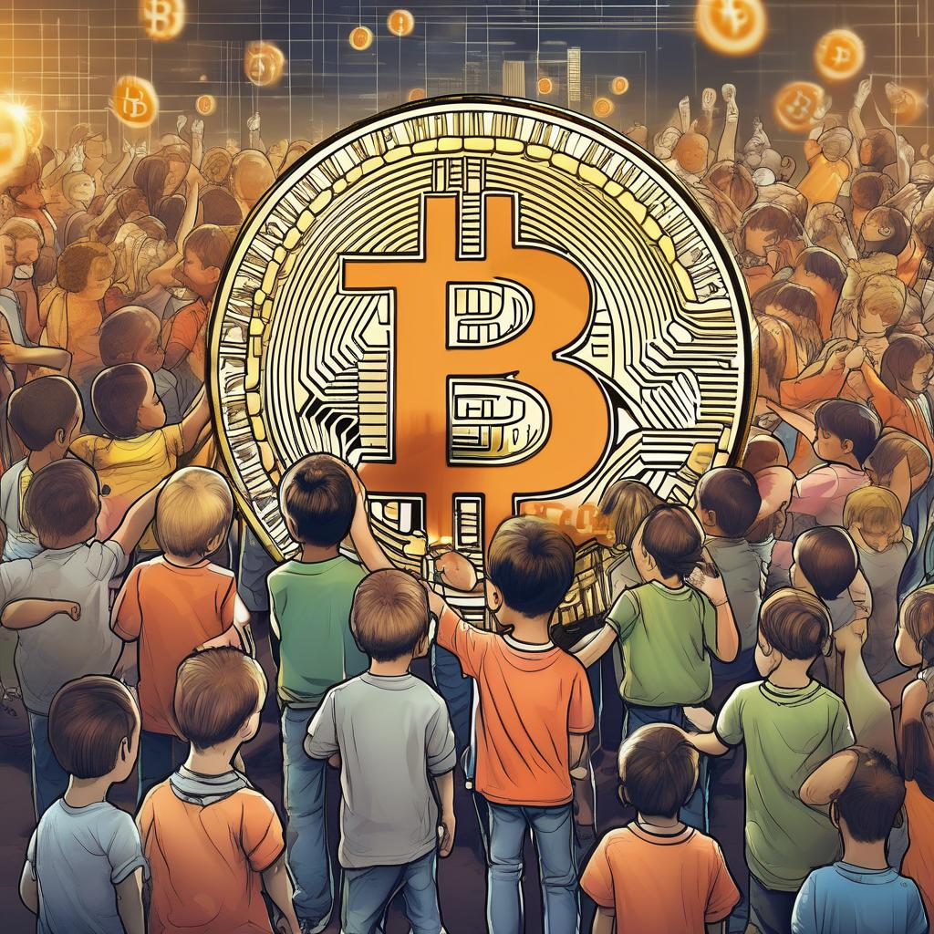
Bitcoin for children
What makes something money
Monetary scarcity concept
Monetary custody concept
Monetary velocity concept
Peer 2 Peer
Value 4 Value
Tools

